Slide 1
Tybee Field Study 2019

Slide 2
5th grade Tybee Experience
Each year, Decatur's 4/5 Academy sends the entire 5th grade on a 3-day Intensive Ecology Field Study to Tybee Island. The field study is led by guides under the supervision of the UGA Dept. of Biology & Ecology, and is held at the Burton 4-H Center. The Burton 4-H Center Environmental Education Program is administered by the University of Georgia Cooperative Extension.
While at Tybee, students receive hands on instruction that correlates to several of our life and physical science standards.
Landforms of Georgia
Effects of constructive forces
Effects of destructive forces
Classification of organisms Click on the link below to learn more!
Cells and microorganisms
4H Burton Center Tybee Experience

Slide 3
Interested in being a chaperone?
Chaperone cost $125 + $50 Background Check
Duties:
--Supervise the students during the learning experiences
-Join in with the students during the classes
-Monitor the behavior of students and redirect when necessary
-Monitor the students in the dorms during the day and night
-Learn something and enjoy yourselves!

Slide 4
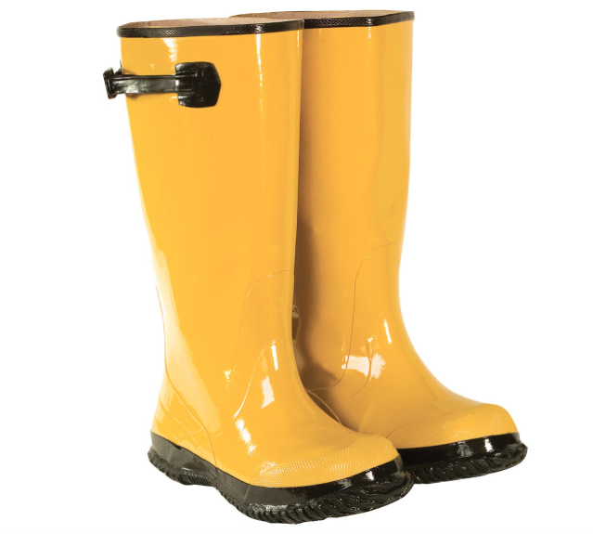
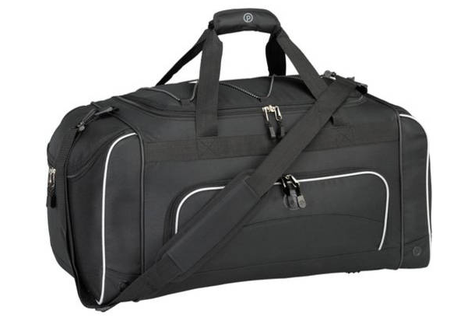
What do I bring to Tybee?
Tybee packing checklist

Slide 5
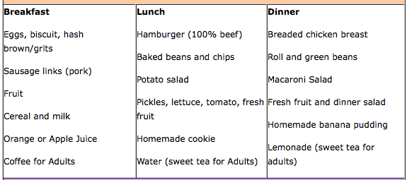
What is the menu?
Food Allergies/ restrictions
If your child has a food allergy/ restrictions you will complete the appropriate form in the information packet. Please be specific.
Tybee does not prepare alternative menu items unless they have advance notice as indicated on the food allergy information form.
The above menu items are representative of meals served at the Burton 4-H Center to children and adults. Meals typically include 1 entrée item, 2 side dishes, 1 drink and 1 dessert (lunch and dinner).
Special Diet Menu
Notes:
Food menu

Slide 6
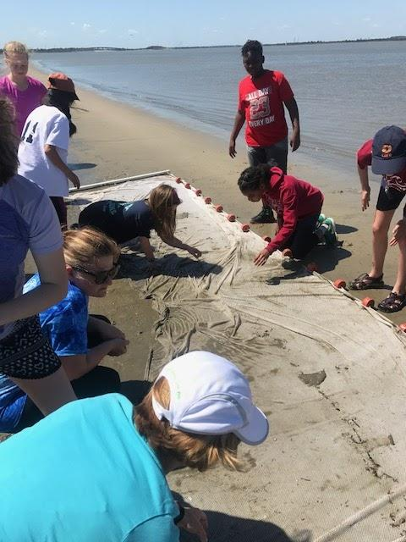
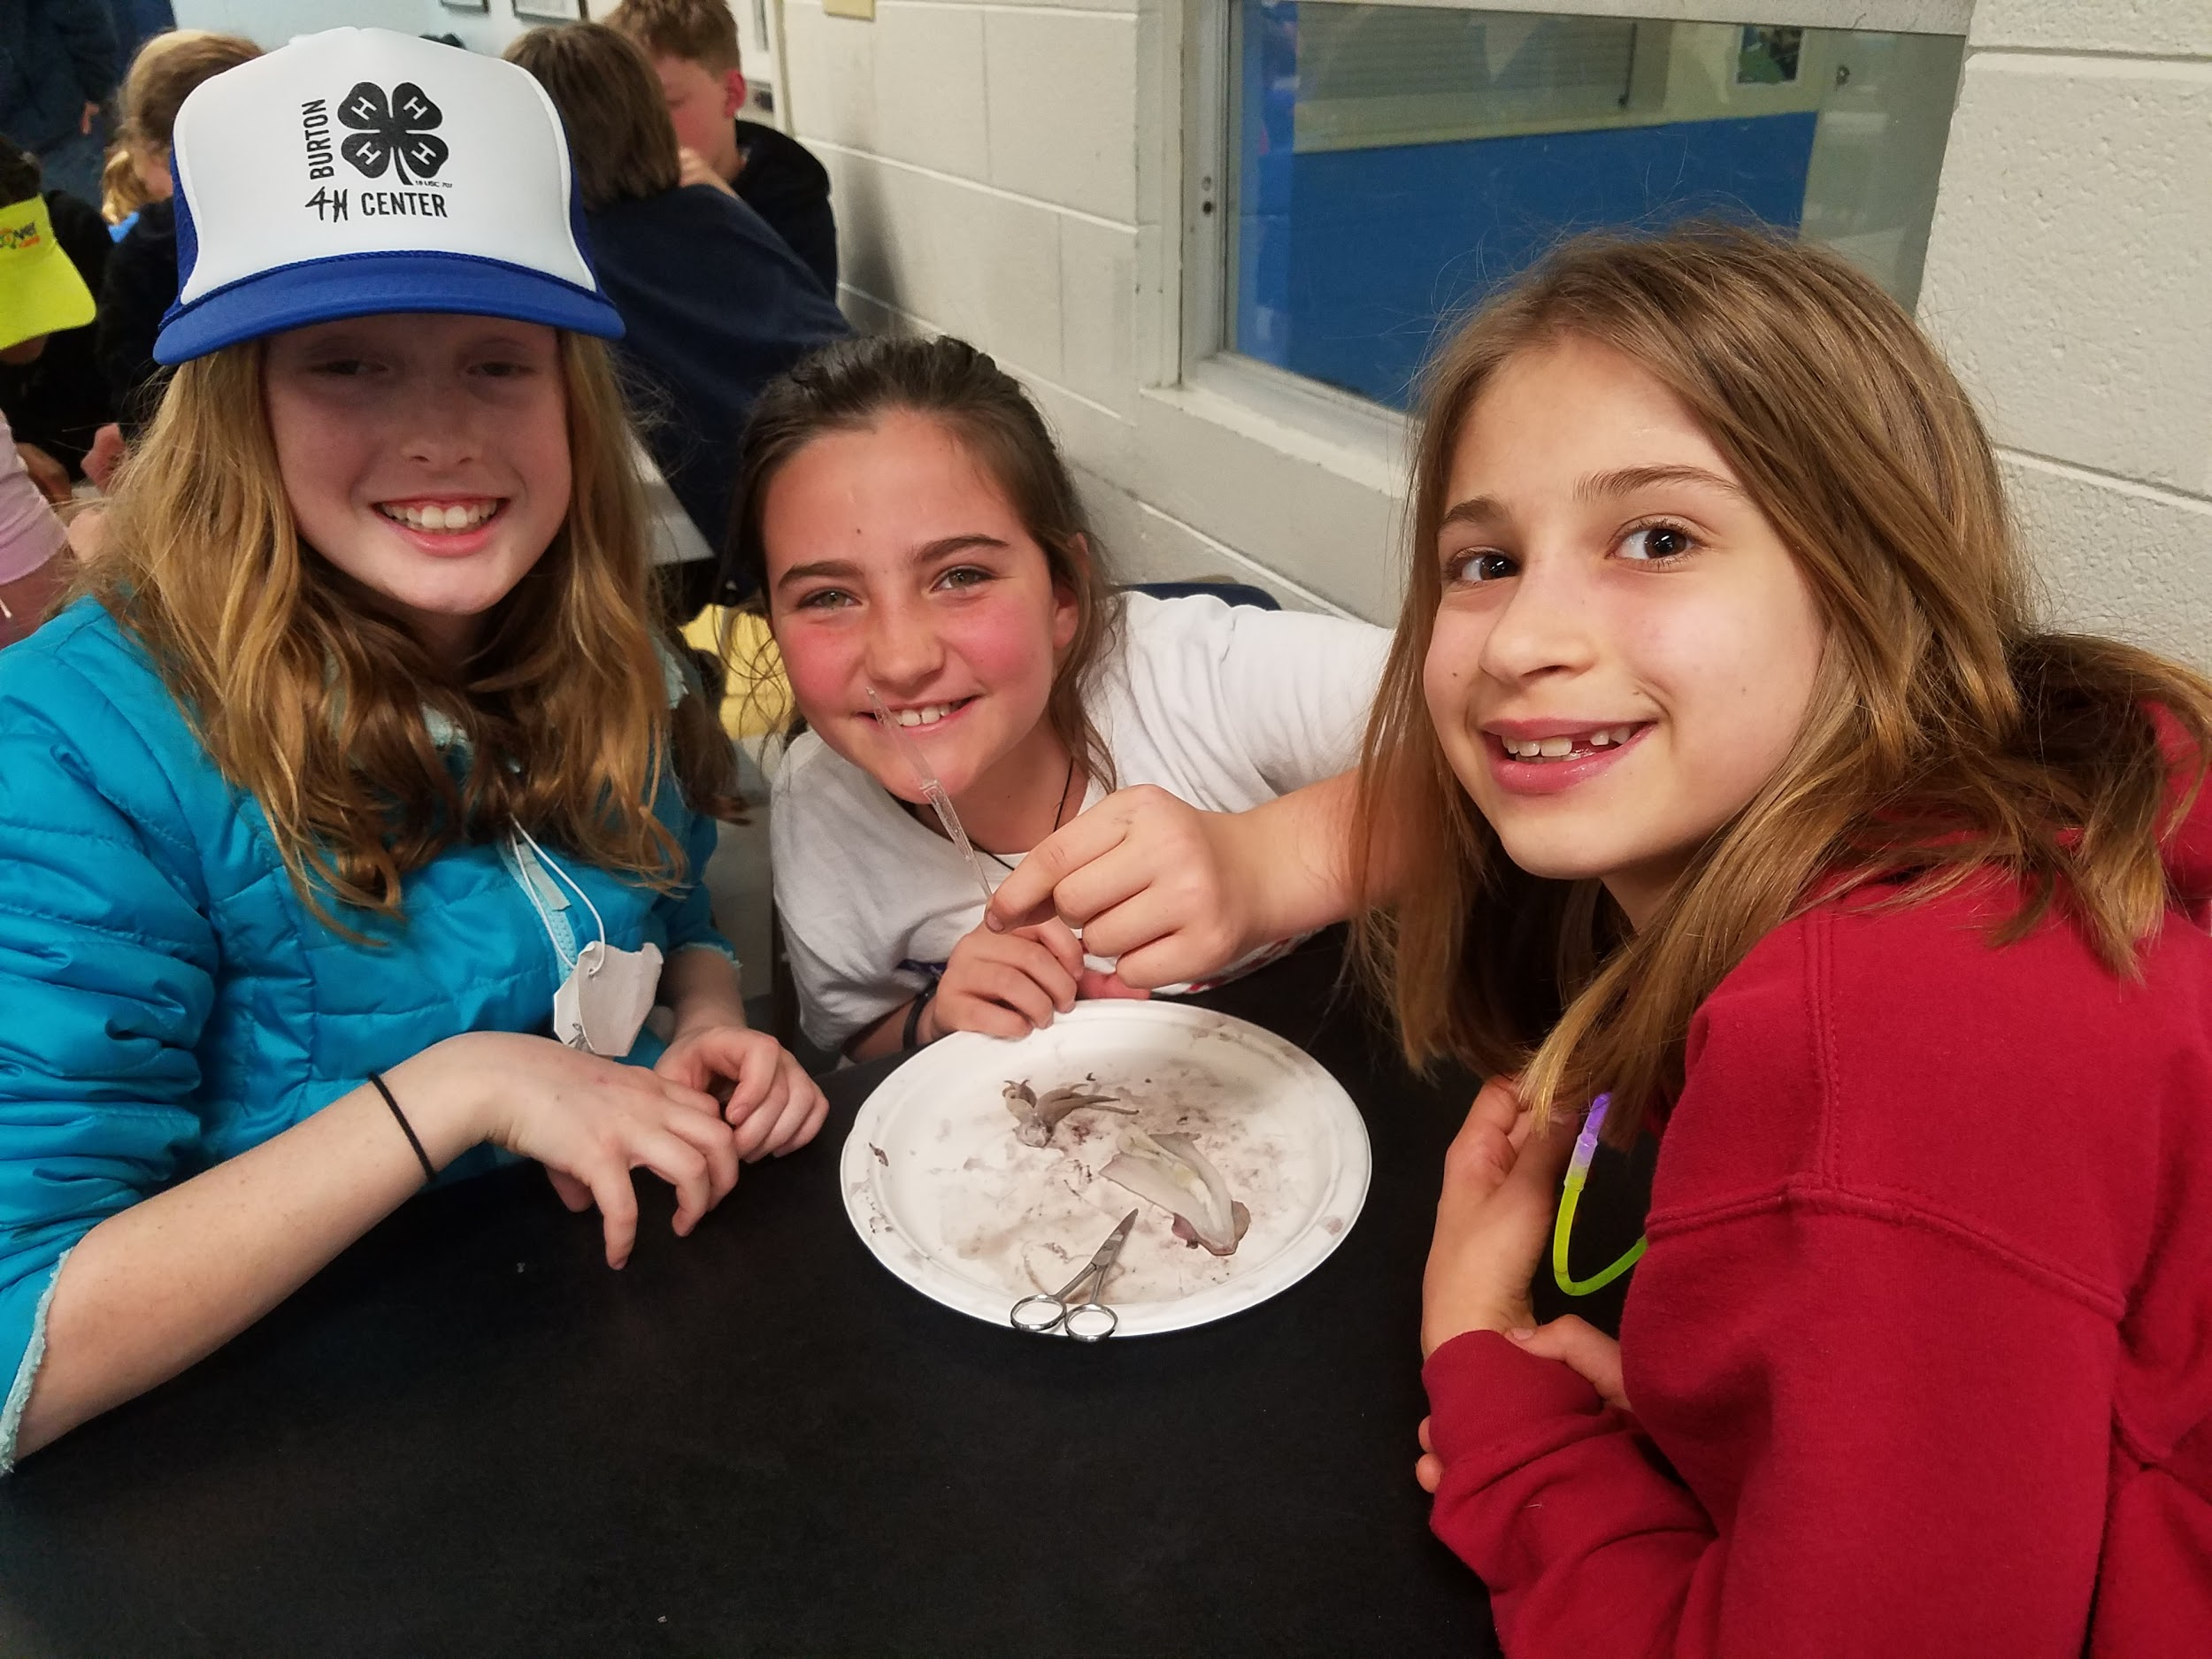
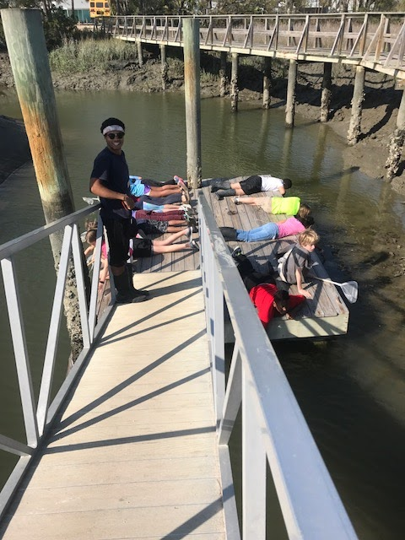
FAVE at Tybee
Notes:
Pictures of tybee site

Slide 7
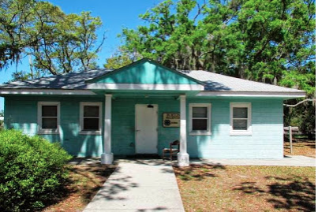
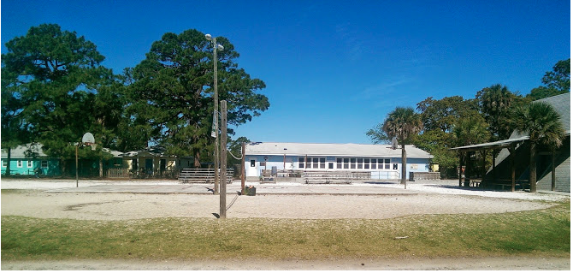
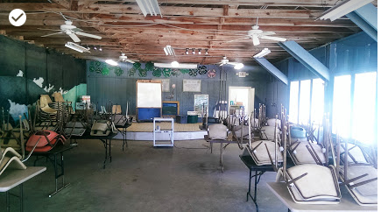
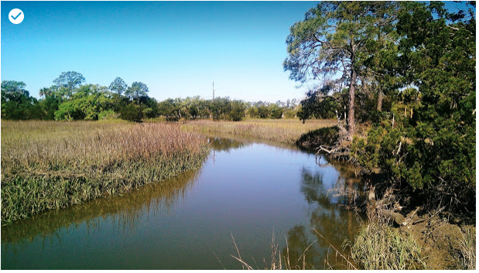
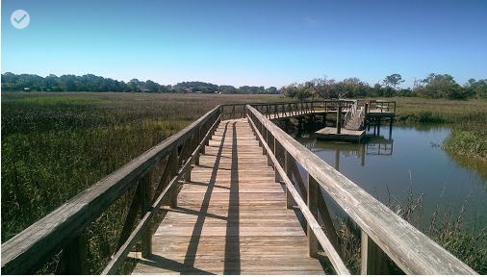
What does Tybee look like?
Dorm Outdoor Space Classroom space
Marsh Wetland Monitoring
Tybee Facilities
Notes:
Pics of tybee site

Slide 8
FAQ’s
1.Does my child need to bring money?
There is a canteen where students may buy drinks, snacks, disposable cameras, shark necklace or a Tybee t-shirt. Please do not send anymore than $20.
2. What if my child gets sick or hurt?
There is first aid care onsite and a hospital close by if it is a serious condition.
3. Does the 4-H center accommodate special diets?
The 4-H center can accommodate a vegetarian and gluten free diet..
Notes:
FAQ

Slide 9
FAQ’s continued...
4. Can I call my child while they are away on the overnight excursion?
We don’t encourage calling your children while they are away. It can cause undue homesickness.
5. Can my child bring their cell phone/electronic games/electronic readers?
No, teachers will have your contact information and the school is always able to contact the staff/facility. Students are not allowed to bring electronic devices.
6. Can I send in a donation to help a child who may need financial support?
Yes, when you receive the information packet there is a separate form to fill out to send in a donation. You will receive a separate receipt for the donation to use for tax purposes.

Slide 10
FAQ Continued….
7. Should my child bring snacks?
No, you do not need to send additional snacks/ food. Snacks will be supplied on the bus trip to Tybee and the return trip back.
8. Can my child choose their dorm or dorm mates?
No, those decisions are made by the teachers based on space.
9. What if I have other questions related to the trip?
Contact your child’s teacher by email.

